Slide 1
PyLOSt – HDX .dat format update
Murilo Bazan da Silva (DLS Optics & Metrology group)
This report aims to validate some changes made to the PyLOSt 0.1.0 to be able to load and stitch data from Zygo’s HDX Fizeau .dat format generated from Zygo’s Mx software

Slide 2
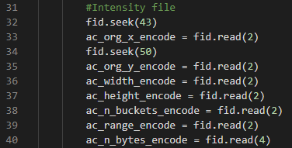
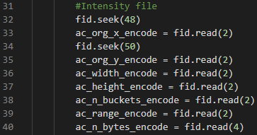
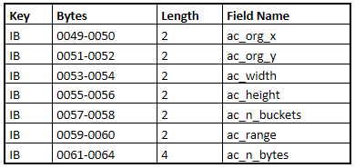
PyLOSt\data_in\fizeau → read_dat.py update 1
According to the Mx help file describing the .dat format, the ac_org_x is located at Bytes 0049 – 0050 (Not sure if it is different for the MetroPro).

Slide 3
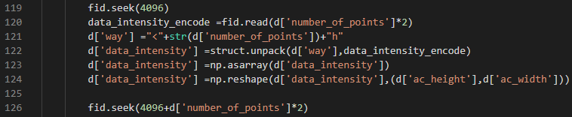
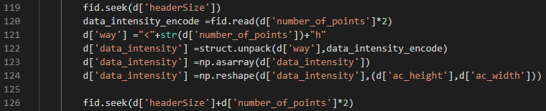
PyLOSt\data_in\fizeau → read_dat.py update 2
According to the Mx help file citation above, the intensity data matrix starts right after the header. So, by applying the header size to the .seek() method it is possible to jump straight to the data part of the file (it was necessary to correctly load HDX .dat data)

Slide 4
PyLOSt\data_in\fizeau → dat_to_h5.py update 1
Mx ‘not expected’ behaviour – when saving processed data through Mx to a .dat file it might not save any intensity data (although we are more interested in the surface data, still trying to figure what is happening). This creates a file with no intensity data. There is no problem with loading the data with the updates made in the previous slides but when dat_to_h5.py is working into converting the data to the h5 format.

Slide 5


PyLOSt\data_in\fizeau → dat_to_h5.py update 1 (cont.)
Because there is a chance to have no intensity data available, there is also the problem that ‘ac_height’ and ‘ac_width’ might be 0 due to that same problem. To avoid that, we’d use the camera height and width to determine the size of the map that will receive the data. On Mx HDX .dat data the ‘cn_org_x’ and ‘cn_org_y’ are based on the camera width and height so it wasn’t a problem.

Slide 6



PyLOSt\data_in\fizeau → dat_to_h5.py update 1 (cont.)
The same modification made before had to be applied to other parts of the code as well.

Slide 7

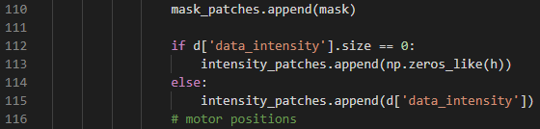
PyLOSt\data_in\fizeau → dat_to_h5.py update 2
When there is no intensity data in the file, ‘data_intensity’ part of the dictionary returns empty and it was stopping the creation of the h5 file. To overcome this, a simple test logic verify if the loaded intensity matrix has size 0, if it does, it appends a matrix of 0s with the shape it was expected to have.

Slide 8
Summary
The updates shown in this report were necessary to correct transform a set of .dat files generated from Zygo’s Mx to the .h5 file format supported by PyLOSt.
We were also able to stitch the data to form a full map using the ‘matrix_overlaperr’ algorithm after the proper data conversion was applied.
The PyLOSt version that was changed during this implementation was version 0.1.0 . All changes were tested using the executable version of the software.

